Slide 1
Using GSR data for determining cognitive load
Guido Zuidhof
December 2014

Slide 2
Cognitive Load
The amount of information a human is trying to process in working memory at any one time.
(Sweller, 1999)

Slide 3
Why determine cognitive load?
Classroom applications
Automatic difficulty adjustment in applications (such as games)
“You should take a break”
People on the autism spectrum do display physiological response
Notes:
People with autism find it hard to become aware / communicate cognitive load

Slide 4
Cognitive load measurement
Many approaches to measuring cognitive load
R. Brünken et al. (2003), Direct Measurement of Cognitive Load in Multimedia Learning. Educational Psychologist 38(1), 53-61
 | Indirect | Direct
Subjective | Self-reported invested mental effort | Self-reported stress level Self-reported difficulty of materials
Objective | Physiological measures Behavioral measures Learning outcome measures | Dual-task performance Brain activity measures (e.g. fMRI) (arguably also indirect)

Slide 5
Cognitive load measurement
Many approaches to measuring cognitive load
 | Indirect | Direct
Subjective | Self-reported invested mental effort | Self-reported stress level Self-reported difficulty of materials
Objective | Physiological measures Behavioral measures Learning outcome measures | Dual-task performance Brain activity measures (e.g. fMRI) (arguably also indirect)

Slide 6
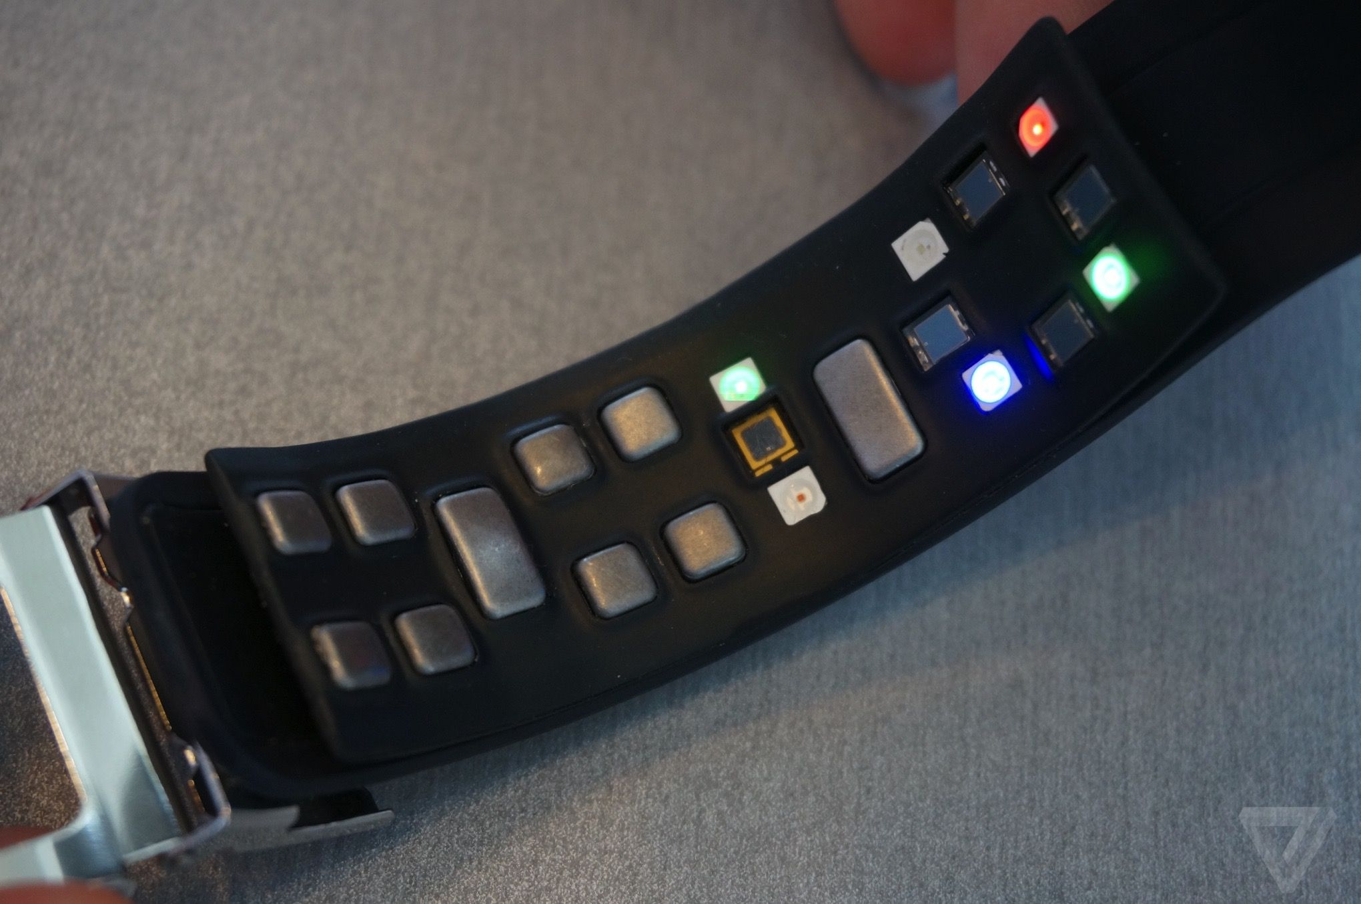
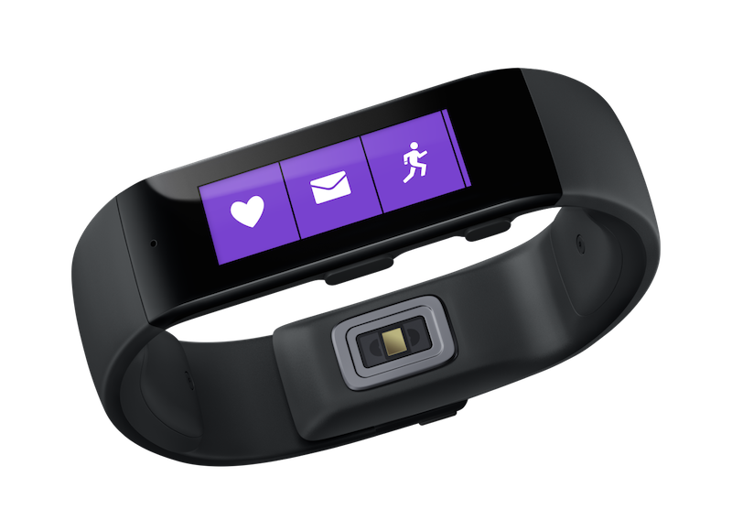
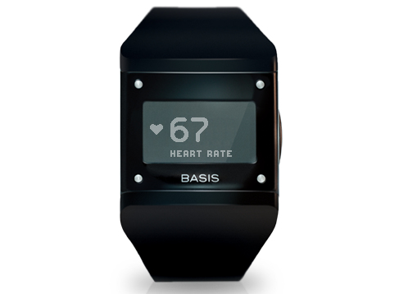
New consumer electronics can measure biometrics
APIs are generally lacking, data is locked in proprietary apps
Samsung Simband
Microsoft Band
BASIS Watch

Slide 7
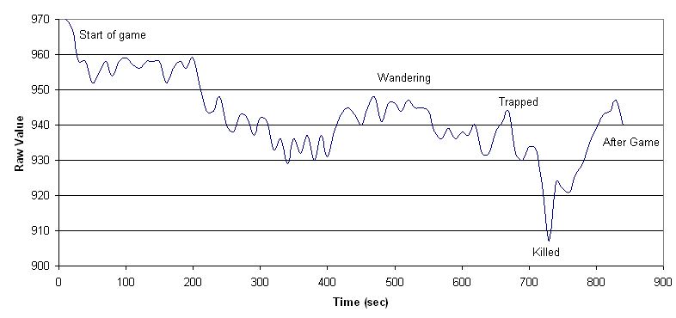
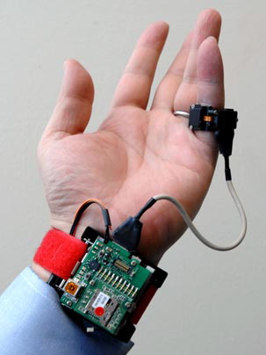
Physiological response
The body responds when cognitive load is increased/reduced
Many different options for measuring, like:
Blood oxygen level
Skin temperature / heat flux
Blood pressure
Motion (accelerometer)
Heart rate variability
Respiratory rate
Galvanic Skin Response
Facial expressions
Pupil dilation
Measuring these is often not mutually exclusive
Notes:
Multiple can be measured simultaneously

Slide 8
Physiological response
The body responds when cognitive load is increased/reduced
Many different options for measuring, like:
Blood oxygen level
Skin temperature / heat flux
Blood pressure
Motion (accelerometer)
Heart rate variability
Respiratory rate
Galvanic Skin Response (GSR)
Facial expressions
Pupil dilation

Slide 9
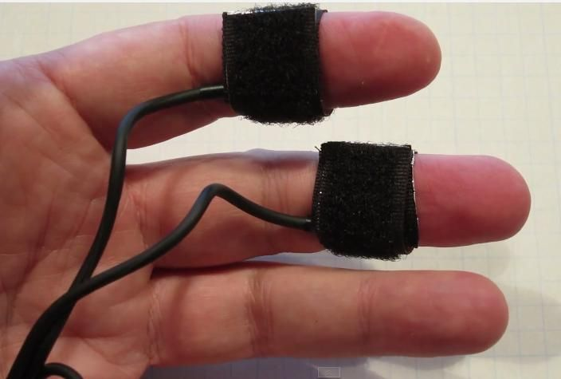
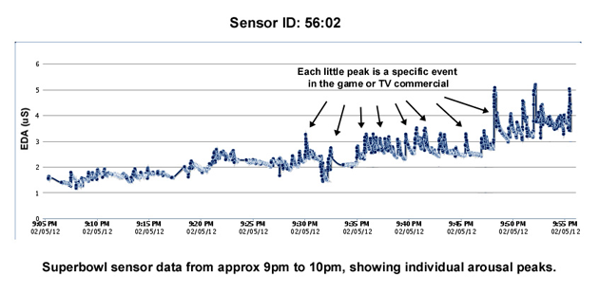
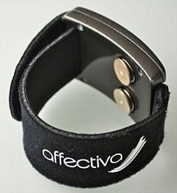
Galvanic Skin Response (GSR)
Measuring the electrical skin conductance
Small voltage applied to electrodes, flowing current measured
Unit of measurement: μS (microsiemens)
Influenced by sweat glands
Delay between stimulus and response between 0.8 and 4 seconds
Notes:
GSR is measuring the electrical skin conductance,
Unit of measurement is micro siemens
More sweat -> higher conductance, sweating caused by primitive ‘fight or flight’ response, preparing for exertion to deal with threat
Delayed response

Slide 10
Goal
Determining cognitive load from GSR data
Method
Measure GSR data using tasks with varying difficulty
Classify task difficulty from features of the GSR data

Slide 11
Experiment
Arithmetic tasks with varying difficulty
Addition of four numbers, presented one by one
4 difficulty levels
8 tasks per subject, in random order
Difficulty | Example Task
1 | 0 + 1 + 1 + 1
2 | 3 + 5 + 7 + 2
3 | 31 + 40 + 67 + 24
4 | 163 + 721 + 573 + 594

Slide 12
***

Slide 13
48

Slide 14
71

Slide 15
50

Slide 16
34

Slide 17
203
196
199

Slide 18
**

Slide 19
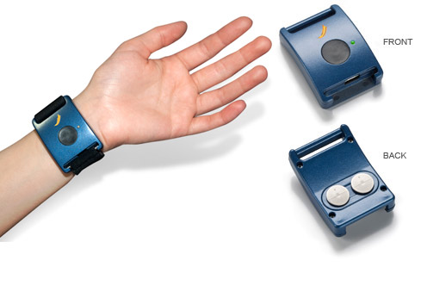
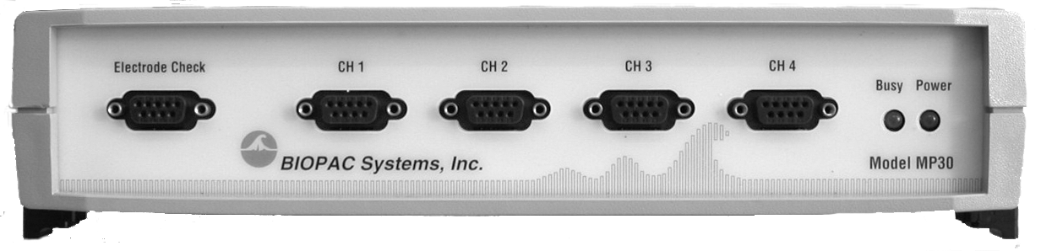
Apparatus
Affectiva Q Sensor (dry electrodes on wrist)
BIOPAC MP30
(wet finger electrodes)

Slide 20
Q Sensor Data
Data proved unusable, proper connection to skin not present in many subjects
Needs some sweat present from the get-go
Lesson learned:
Have subjects wear them longer before the first task starts
Ask subjects to do some mild exercise beforehand

Slide 21
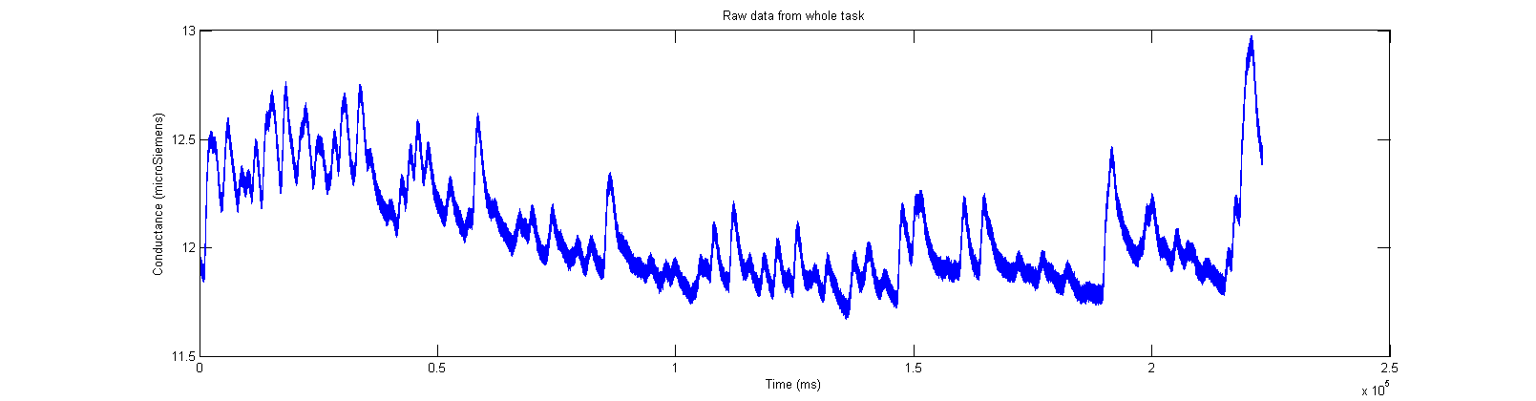
Raw data

Slide 22
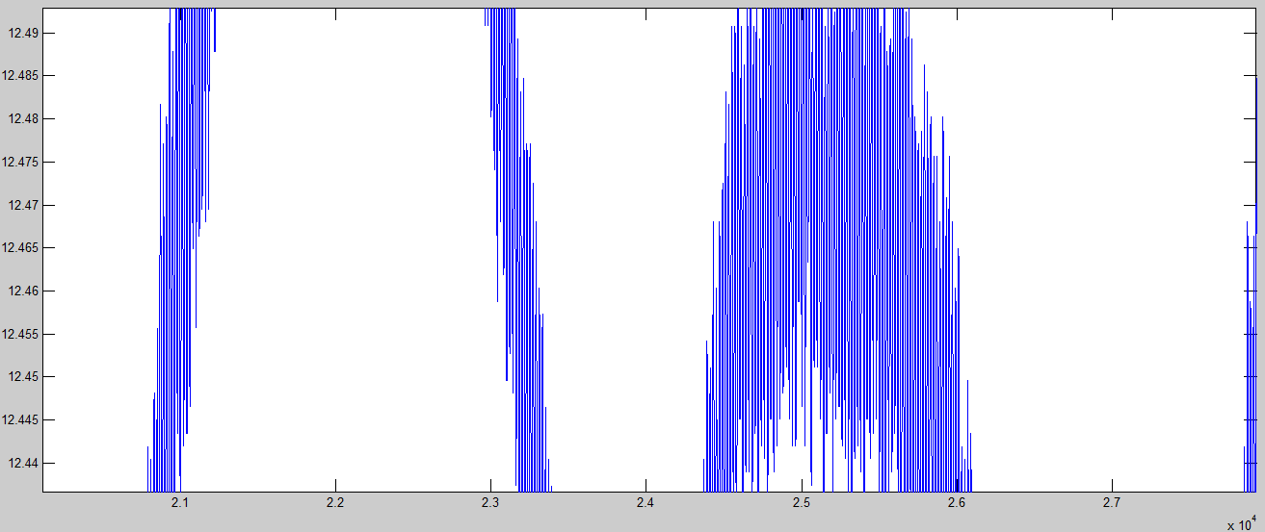
Raw data
DC current noise (50Hz) in signal

Slide 23
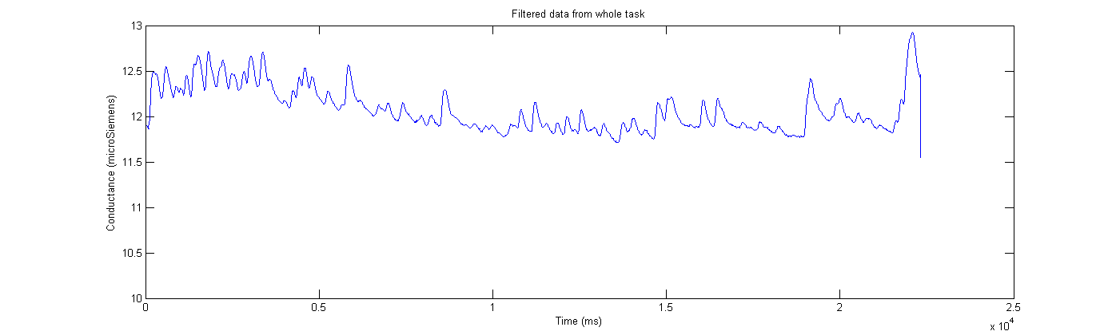
Preprocessing
Smoothing filter (removing DC current)
(Savitzky-Golay filtering)
Notes:
Low Pass Filter didn´t cut it

Slide 24
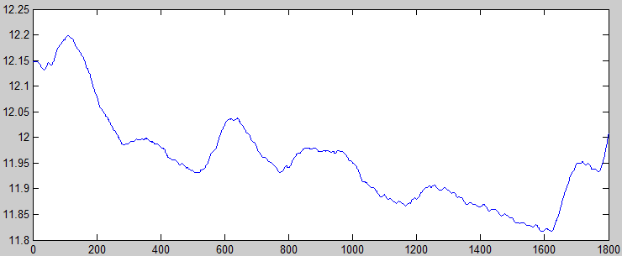
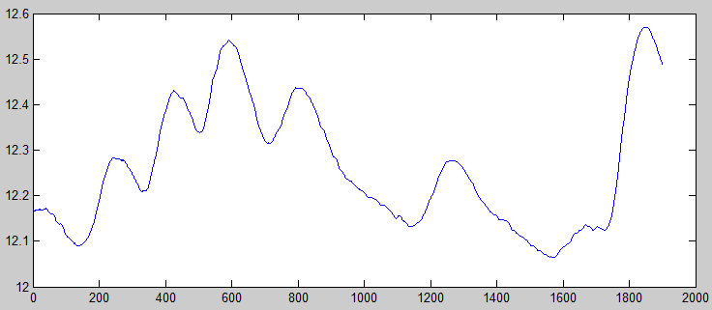
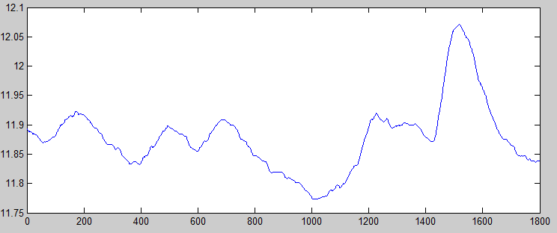
Preprocessing
Cutting the tasks out of the data
...

Slide 25
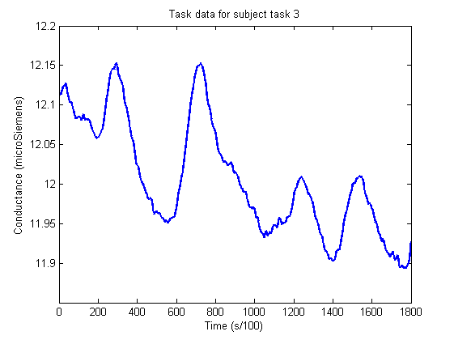
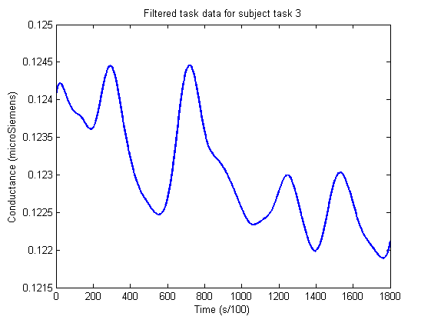
Final preprocessing
Normalizing (dividing by subject average GSR over all tasks)
Smoothing out small DC current spikes (Savitzky-Golay filtering)

Slide 26
Transformation
Extract time domain features
Export to an easily parsable format (CSV)
'luc' 'diff2' [221.4503] [0.1230] [7.3118e-04] [0.0020] [6] [6] [5] [4]
Subject, Difficulty,
Accumulative GSR, Average GSR
Standard Deviation, Difference start/end
Peak count with varying tresholds

Slide 27
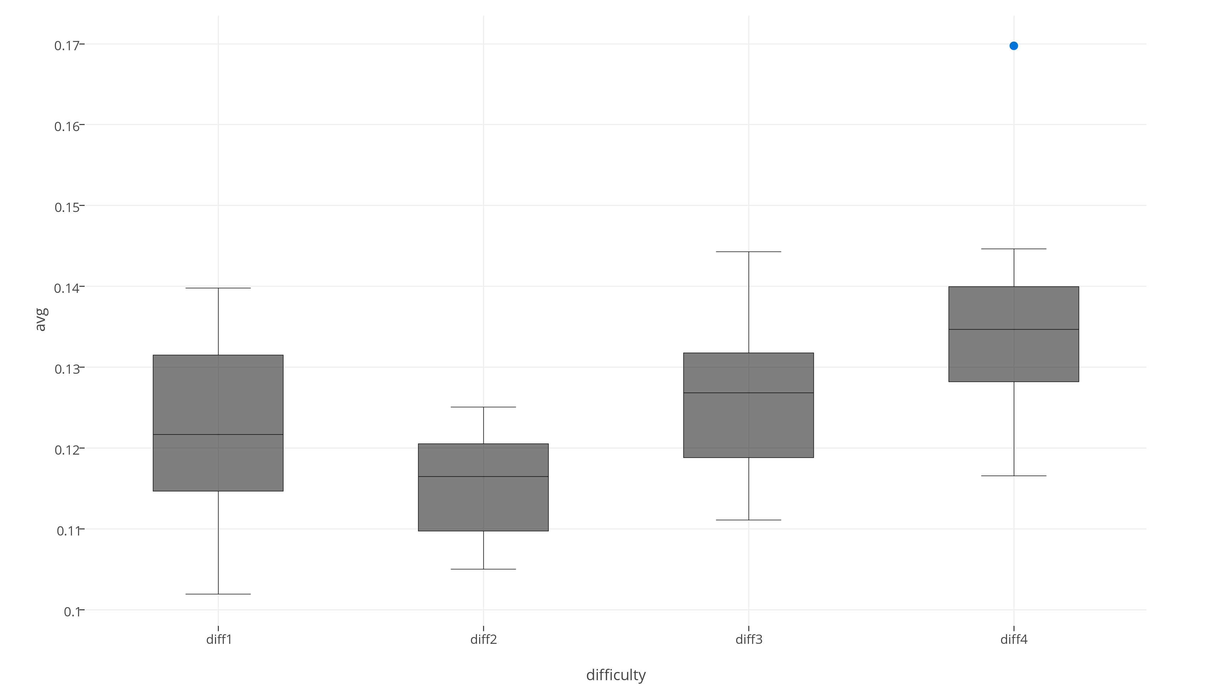
Visualization
Average GSR

Slide 28
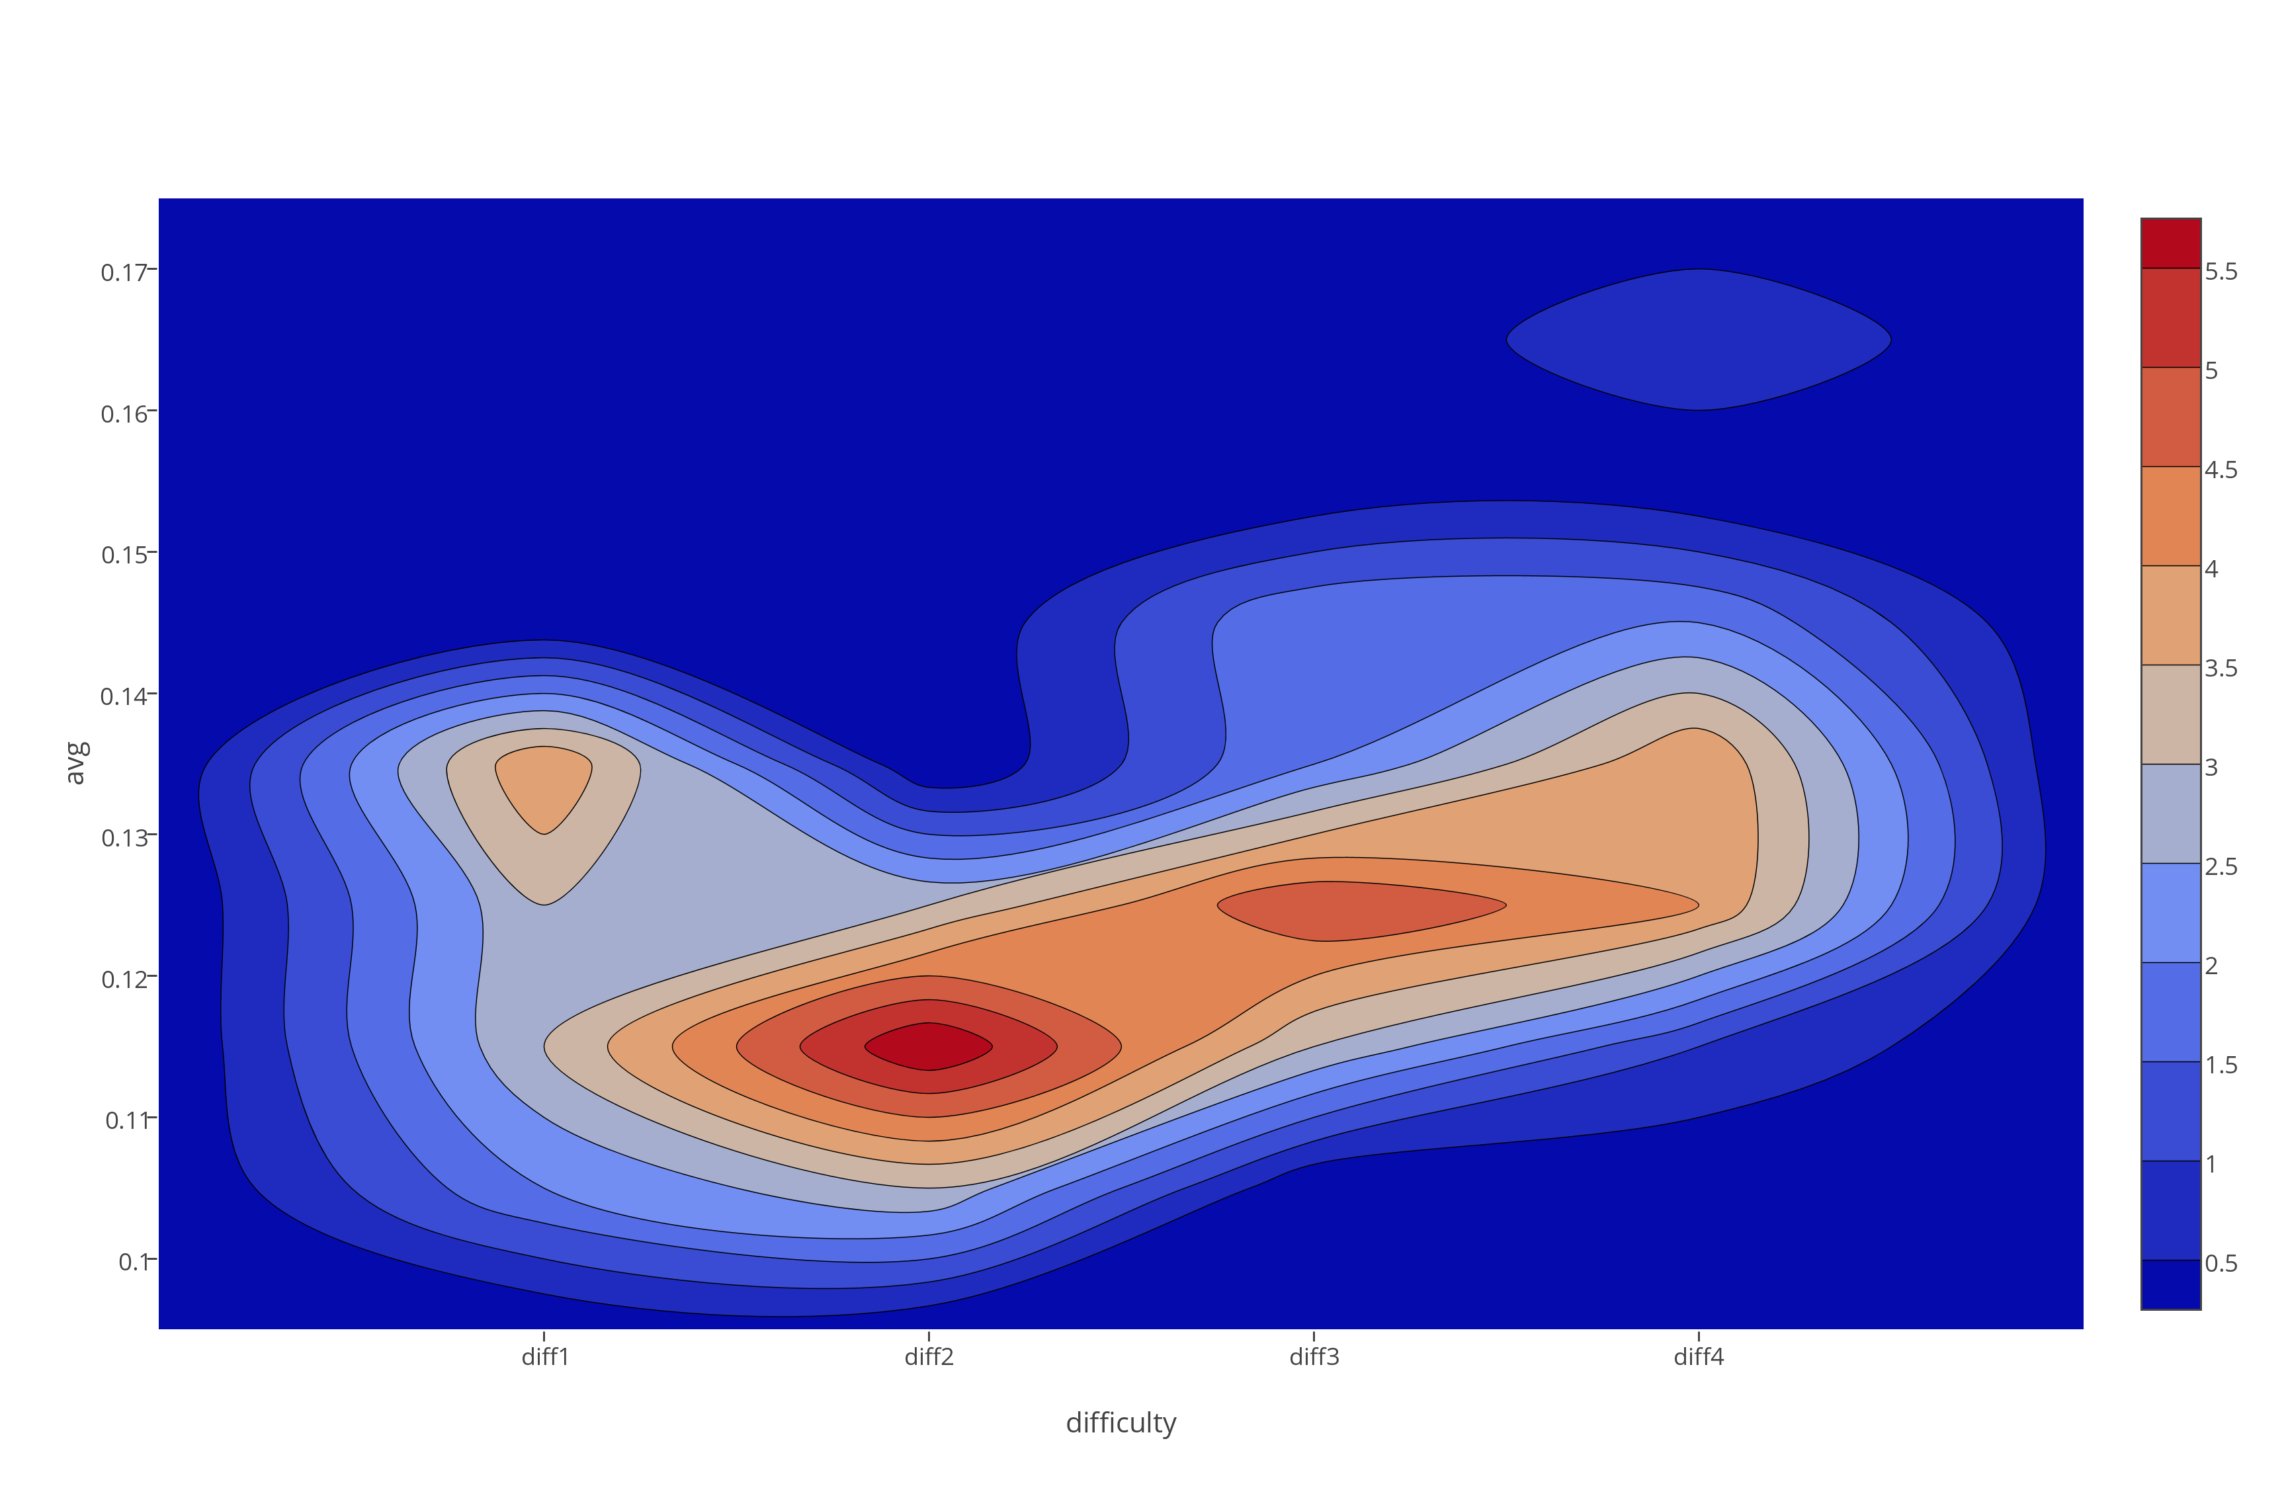
Visualization
Average GSR

Slide 29
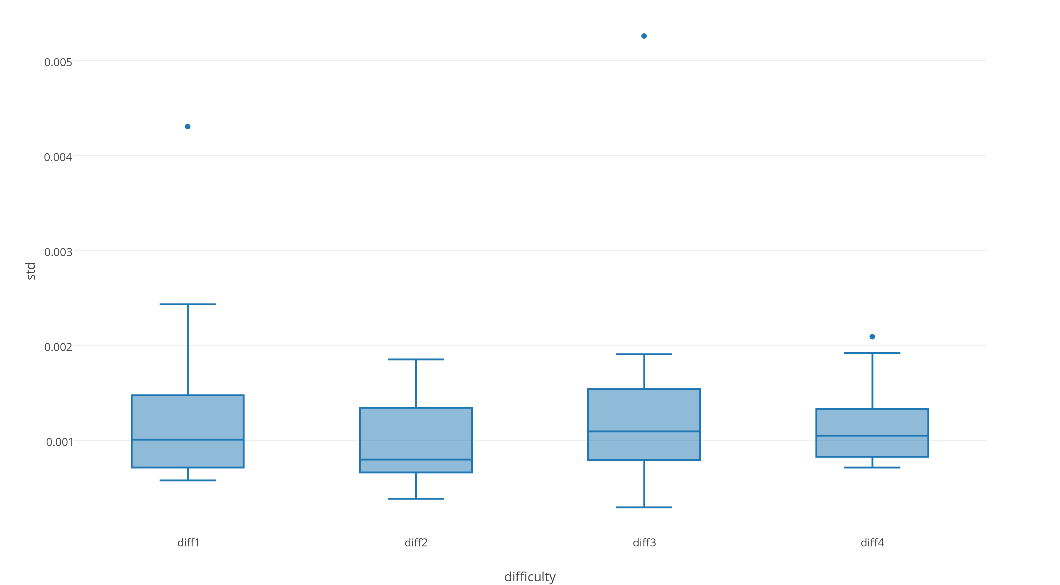
Visualization
Standard Deviation

Slide 30
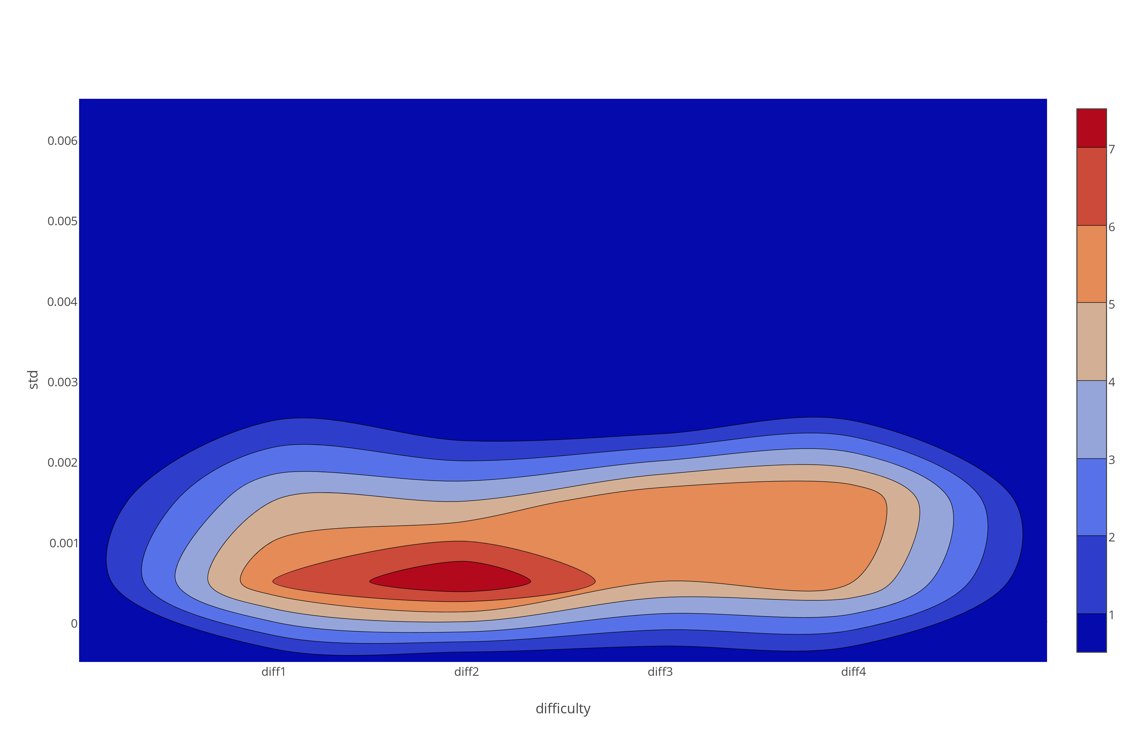
Visualization
Standard Deviation

Slide 31
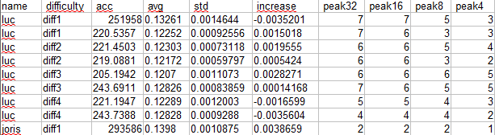

Building a classifier
CSV data fed to Weka Data Mining Software
Easy to try multiple classifier training algorithms

Slide 32
Classification
Can we predict the task difficulty given these features?

Slide 33
Preliminary results
10 Folds cross-validation was used
Classifier | Correctly Classified Instances %
SimpleCart (Minimal Cost Decision Tree) | 33.33%
J48Graft (Decision tree) | 43.75%
BayesNet (Bayesian probability estimation) | 25%
Naïve Bayes | 33.33%
LWL (Locally weighted learning) | 41.67%
Multilayer Perceptron (20 hidden layers) | 29.17%
SMO (Support Vector Machine class algorithm) | 6.25%
JRIP (Rule based learner) | 18.75%
Simple classifiers seem to work best. Expected from small dataset size.
Notes:
Note that 25% is expected from chance
Not great.

Slide 34
Preliminary results
10 Folds cross-validation was used
Classifier | Correct % 4 classes | Correct % 2 classes
SimpleCart (Minimal Cost Decision Tree) | 33.33% | 72.92%
J48Graft (Decision tree) | 43.75% | 77.08%
BayesNet (Bayesian probability estimation) | 25% | 75%
Naïve Bayes | 33.33% | 60.42%
LWL (Locally weighted learning) | 41.67% | 75%
Multilayer Perceptron (20 hidden layers) | 29.17% | 62.50%
SMO (Support Vector Machine class algorithm) | 6.25% | 58.33%
JRIP (Rule based learner) | 18.75% | 79.12%
Notes:
Classifying between task 1,2 and task 3,4 combined
50% expected from chance.
Still not great / good enough

Slide 35
Improving the classification
Classification accuracy is not great however, possible reasons
Small dataset (6 participants * 8 tasks = 48 entries)
Experiment
Design susceptible to ´task bleeding´, i.e. sweat from last task carries over
Sensor inaccuracy
Not the right features extracted from data
It is simply not classifiable better from GSR data

Slide 36
Recap
Using biometrics to determine cognitive load outside of the lab is exciting and potentially useful
I measured GSR during tasks of varying difficulty
Classifying task difficulty from this data is the goal
Next up is seeing whether I can improve this classification by extracting different features

